Slide 1

Analysis on Best Tourist Places
TEAM MEMBERS:
NISHA SINGA-BSC(Datascience)
ISHWARYA NAMPALLI- B.COM(Computers)

Slide 2

Contents
Introduction
Problem statement
Data collection
Libraries used
Interface of Web site
Raw data and cleaned Data
Data cleaning
Outlier Detection
Data visualization
Conclusion
Challenges

Slide 3

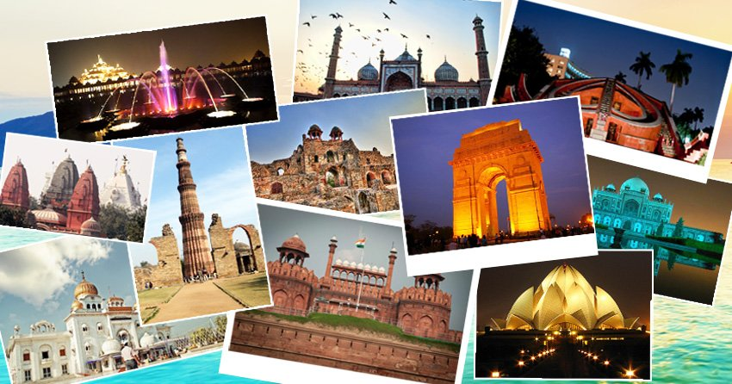

INTRODUCTION:
GetYourGuide is an online travel agency and online marketplace for tour guides and excursions. It is accessible via website and mobile app for iOS and Android. GetYourGuide's sells tours and excursions, activities including cooking classes, and tickets to many tourist attractions. It offers more than 40,000 products worldwide.

Slide 4
PROBLEM STATEMENT
Together the data about best Tourist Places in India.
Low cost Tourist Places based on Price.
Best Tourist Places based on Ratings and Reviews

Slide 5

DATA COLLECTION
GET YOUR GUIDE website has the information related to Tourist Places in India
https://www.getyourguide.com/india-|169037/
We used Beautiful Soup,Requests together to scrape the data from website

Slide 6


LIBRARIES USED
Web Scraping Tools
Python
Beautiful Soup
Requests
Web driver with Selenium

Slide 7

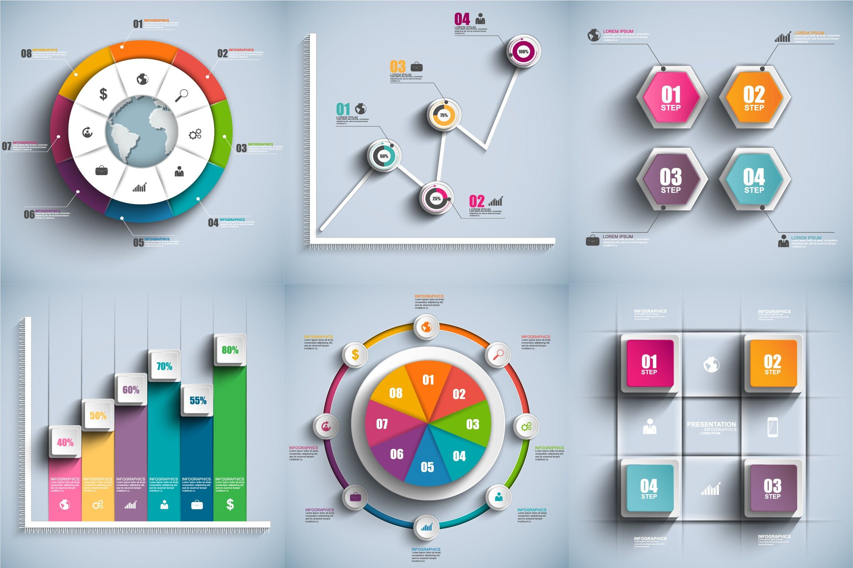

2.DATA CLEANING AND MANIPULATING
Numpy
Pandas
Regular Expresion
3.DATA VISUALIZATION
Matplotlib
Seaborn

Slide 8
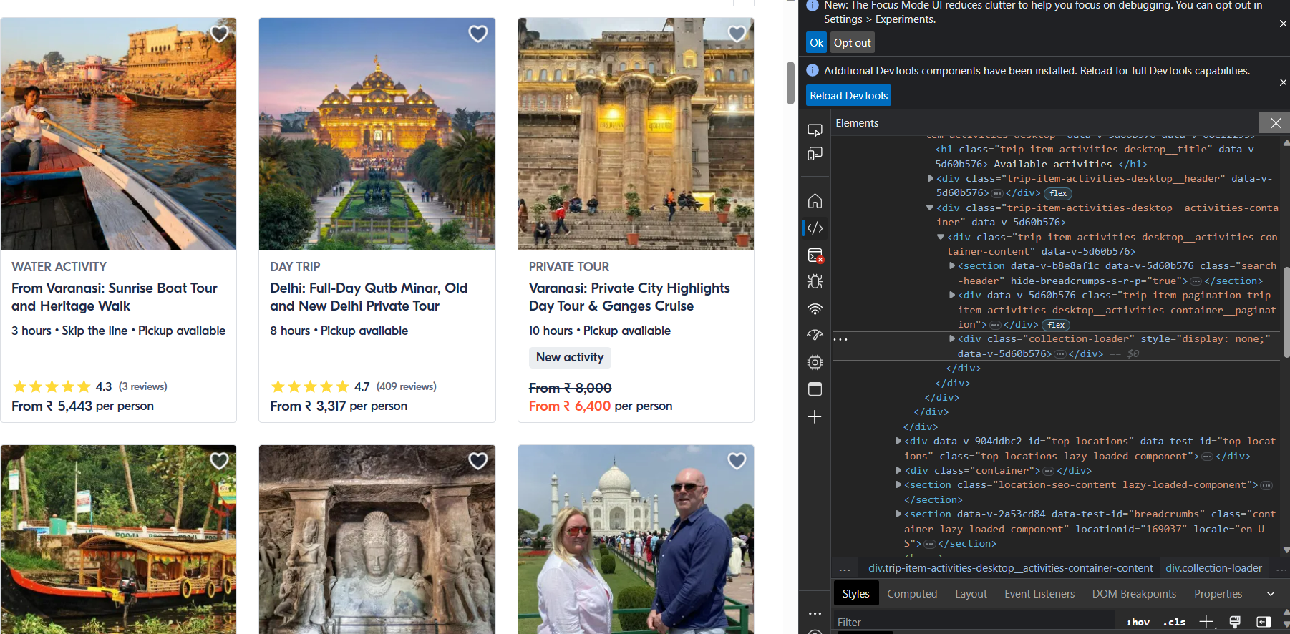
INTERFACE OF THE WEBSITE ALONG WITH INSPECT

Slide 9
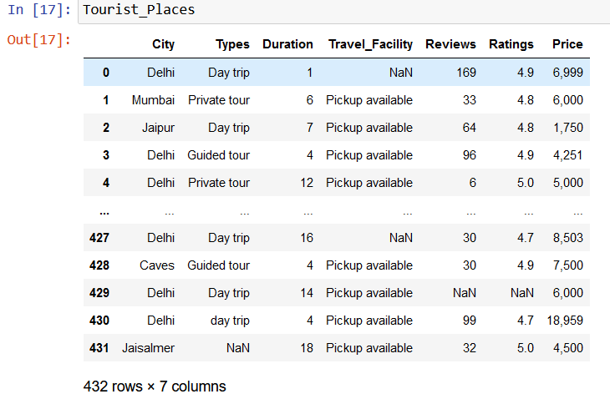

RAW DATA FROM GET YOUR GUIDE

Slide 10

DATA CLEANSING
Check for Duplicates
Removing special characters
Filling NaN values
(bfill,fifll)
Data type conversions

Slide 11
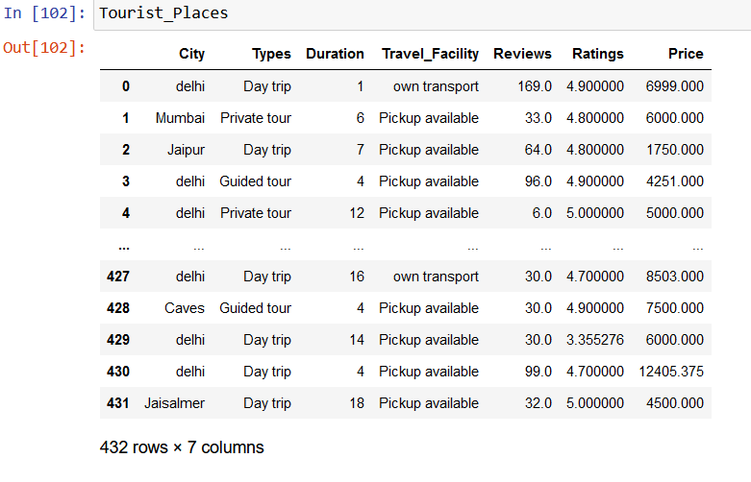

CLEANED DATA

Slide 12
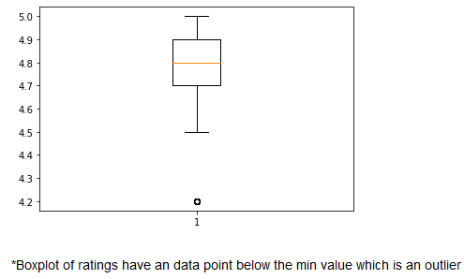
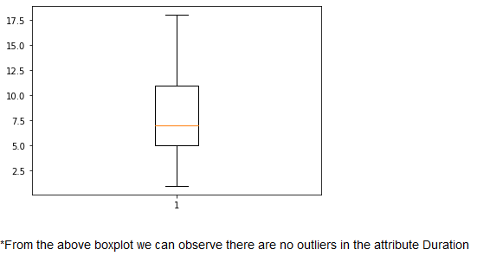
OUTLIER DETECTION
Boxplot for Ratings
Boxplot for Duration

Slide 13

DATA VISUALIZATION​
UNIVARIATE ANALYSIS:
The term univariate analysis refers to the analysis of one variable. (uni-->ONE)
BIVARIATE ANALYSIS:
The term bivariate analysis refers to the analysis of two variables. (bi-->TWO)
MUTIVARIATE ANALYSIS:
The term multivariate analysis refers to the analysis of morethan one variable. (multi-->MORETHAN ONE)

Slide 14
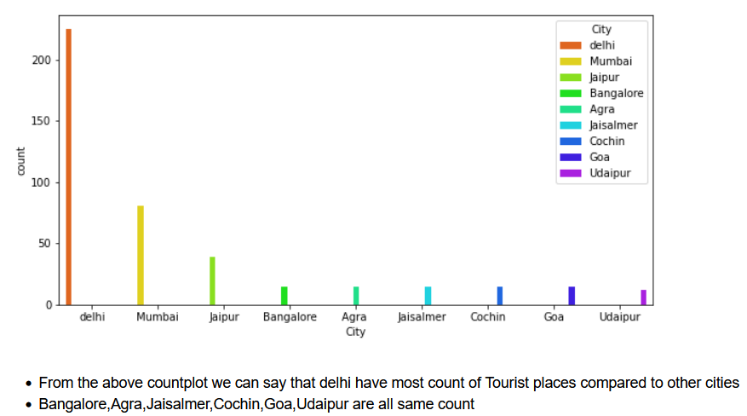
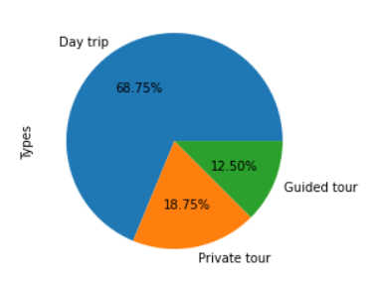

Analysis on cities
Analysis on Types
Above Pie-chart concludes that morethan half of the chart was covered by Day trip with 68.75%
East part of the chart is covered with Guided tour & Private tour

Slide 15
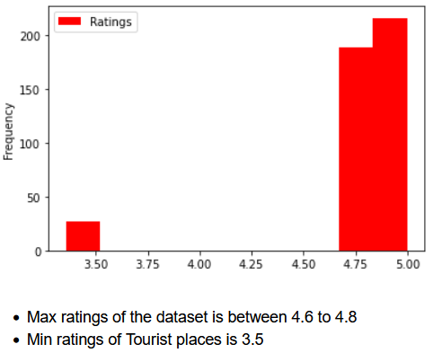
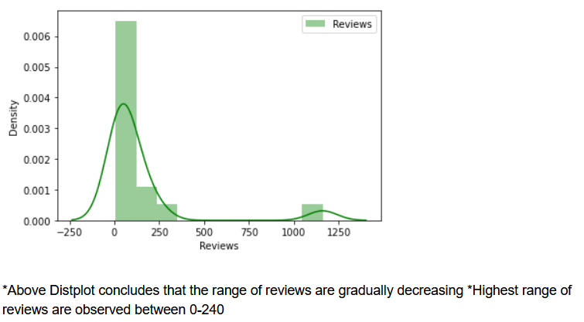
Analysis on Ratings
Analysis on Price

Slide 16
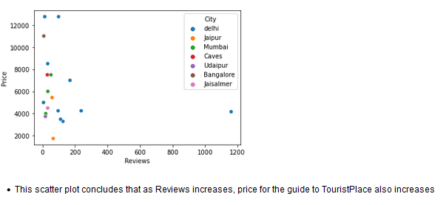

Analysis on Reviews v/s Price

Slide 17
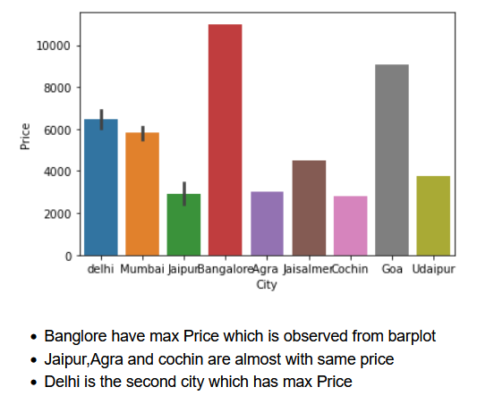
Analysis on City v/s Price

Slide 18
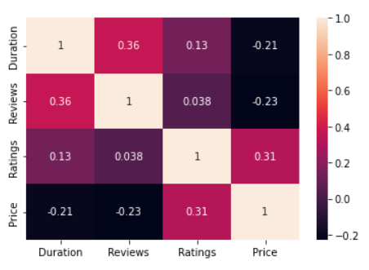
Analysis on Tousrist_Places Dataset
Heatmap shows us about the correlation between each attribute among themselves
When price is increasing the duration is decreasing

Slide 19
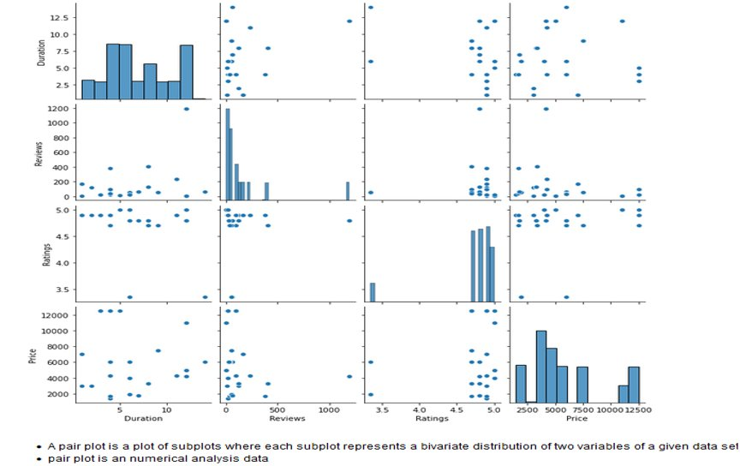
Multivariate Analysis on Numerical Attributes

Slide 20

CONCLUSION
Delhi has most Tourist places compared to all the cities.
Based on Reviews Delhi is the most popular city with more Touristplaces
Reviews and Ratings are related to price of Touristplaces.i.e; As reviews and ratings are increasing price also increases

Slide 21

CHALLENGES
Whenever we restart the kernal data is changing
Faced a challenge while using regularexpressions to get a particular data while inspecting the data from website

Slide 22


